Slide 1
Project Update
March 2021

Slide 2
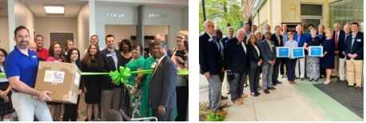
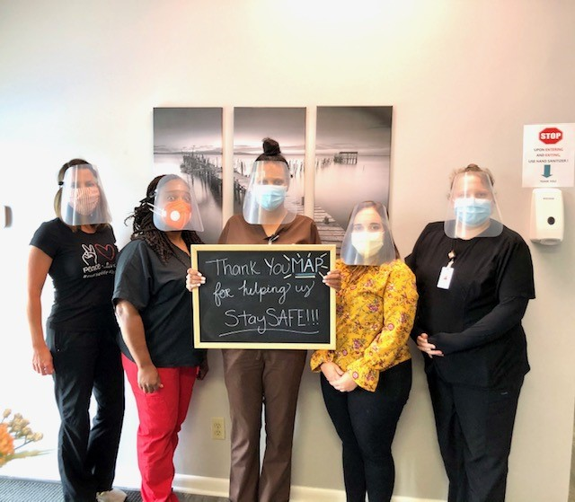
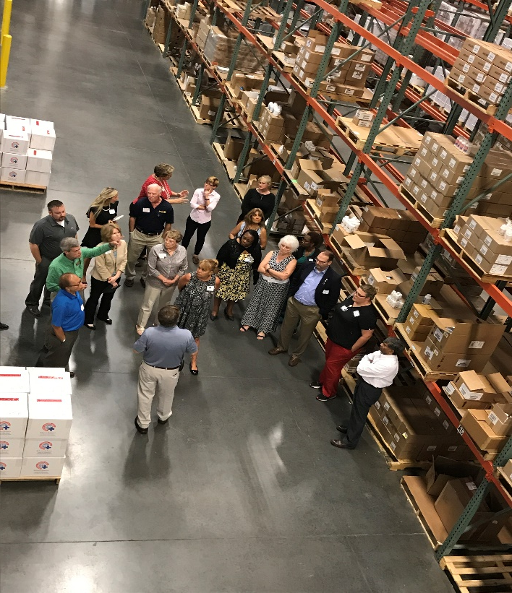
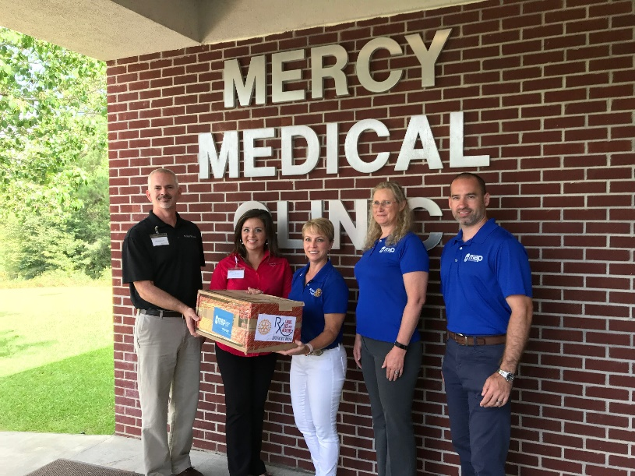
Rotary Opens Opportunities Locally!

Slide 3
Launched in 2017
Partnership with MAP International
Medicines to Patients of Free and Charitable Clinics
Focus on Major Chronic Diseases
Medical Supplies (PPE during COVID)
Shared Support: District 6920 and Clubs

Slide 4
About MAP International
Global Health Nonprofit founded in 1954
Receives donated meds/supplies from 75+ pharma companies
Ships from global distribution center in Brunswick, GA
Last year, shipped $700M+ to 20M people in 86 countries
Supports 27 clinics domestically

Slide 5
Patient and Clinic Stories
“The program has helped our patients greatly. We’ve had quite a few patients who had laundry lists of problems and we have been able to get them medicines for high cholesterol and blood pressure.”
“We have had a higher rate of patients showing up the get their medications, pick up their refills, follow through with their blood work and testing they need done. They are taking a more active role in their health. It has been amazing to watch.”

Slide 6
Patient and Clinic Stories
“This program has been invaluable to our patients. I love helping people and that look in people’s eyes when you hand them the medication that they know they need.”
"I rest easier at night knowing our patients have access to the medications they need to keep them out of the hospital."
"I couldn't afford gas money to get to the pharmacy. I can't thank you enough for providing me with this medication. This is a blessing."

Slide 7
6920 Rotary Clubs Participating
Started
Valdosta, Valdosta North, Nashville-Berrien
2017
Brunswick, St. Simons Island,
Golden Isles, Jekyll Island
2017
Vidalia, Metter, Claxton,
Glennville, Swainsboro, Hazelhurst
2018
2019
Hinesville, Jesup
2019
Augusta, Augusta West

Slide 8
Starting in 2021
10 Area Savannah Clubs
Dublin Club

Slide 9
Impact After 3 Years
4,283 Patients Served
10,026 treatments
Clinic | Year 1 | Year 2 | Year 3
CMAP/CCHS (Brunswick) | 284 | 591 | 120
Partnership Health (Valdosta) | 709 | 736 | 293
Mercy Ministries (Lyons) | 110 | 378 | 250
Diversity Health Center (Hinesville) |  | 70 | 257
St. Vincent de Paul Health (Augusta) |  | 172 | 313
Total | 1,103 | 1,947 | 1,233

Slide 10
Value of Services Provided
$548,000
in medication
and health supplies
October 2017 - December 2020

Slide 11
Improving Chronic Disease Management
Improvement is based on National Committee for Quality Assurance (NCQA) national standards tracked since program enrollment.
Condition | Year 1 - 3 | Oct-Dec 2020
Hypertension | 50% | 89%
Diabetes | 61% | 97%
Cholesterol | 63% | 81%
Asthma | 82% | 92%

Slide 12
Financial Support
Clubs Share – 60%
District Share – 40%
Cost based on # clubs and # patients at the clinic (Currently, club costs range from $16 to $150 per month)

Slide 13
Your Club’s Opportunities
When it’s safe, visit your Clinic, learn what their challenges are, invite speakers
Attract additional financial support for Saving Lives with Medicine!
Foundations? Businesses? Individuals?

Slide 14
Questions?
Tom Woodbery
Assistant Governor
(478) 737-2771
twoodbery@gmail.com

